Slide 1
Image Gradients & Edge Detection
Dr. Rongzhong Li
CSC391/691 Fall 2016

Slide 2
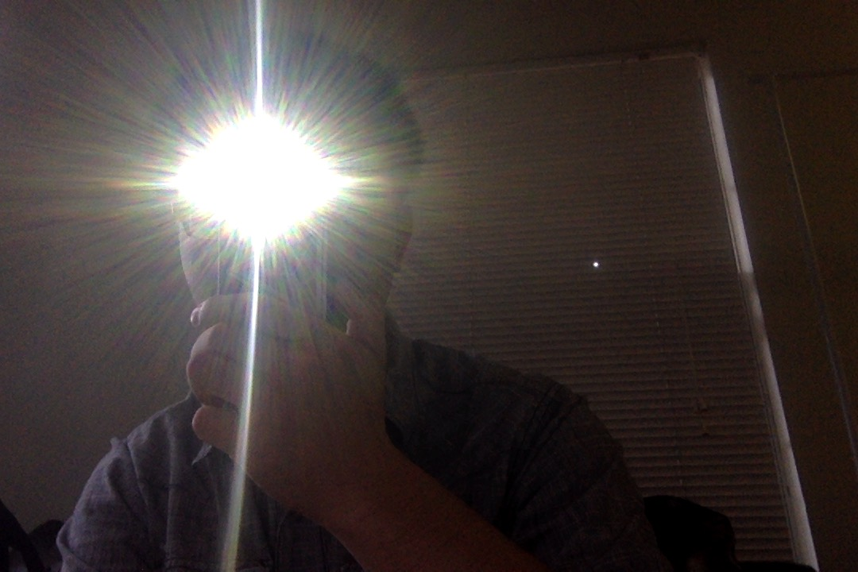
Short Discussion on Basic Pixel Operations
What CV functionality can you achieve with previously learnt basic pixel operations?
Object tracking?
Notes:
Photobooth
Local Maximum?
Speed?
max heap
camera angle
Avoid CV!

Slide 3
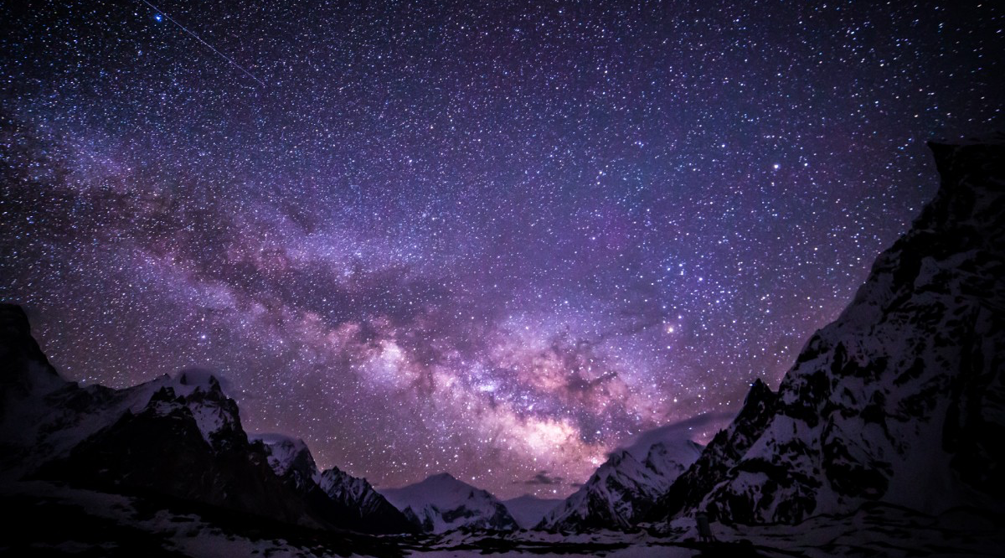
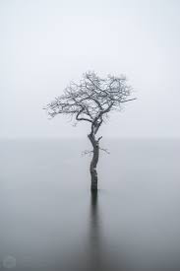

Changes in Images
Notes:
What is interesting part in image?

Slide 4
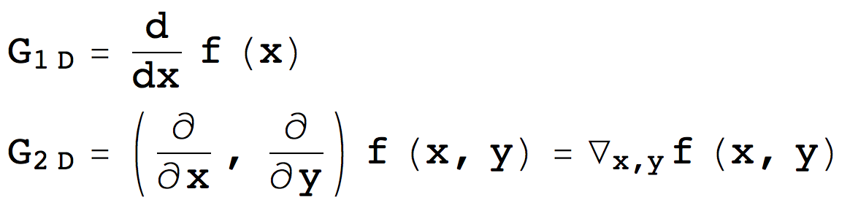
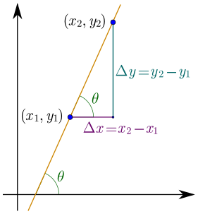
What is Gradient in Mathematics?
The gradient is a generalization of the usual concept of derivative to functions of several variables.
Shows how function value changes on certain directions
Notes:
Gradient is the bridge linking global picture features to local features
Global picture pixels are mostly meaningless and cause distraction
1D is using X-Y, what about 2D?
Understanding the change in image, rather than static status.

Slide 5
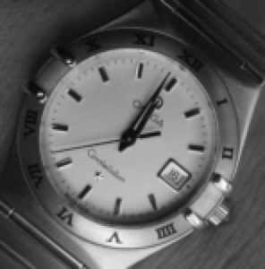
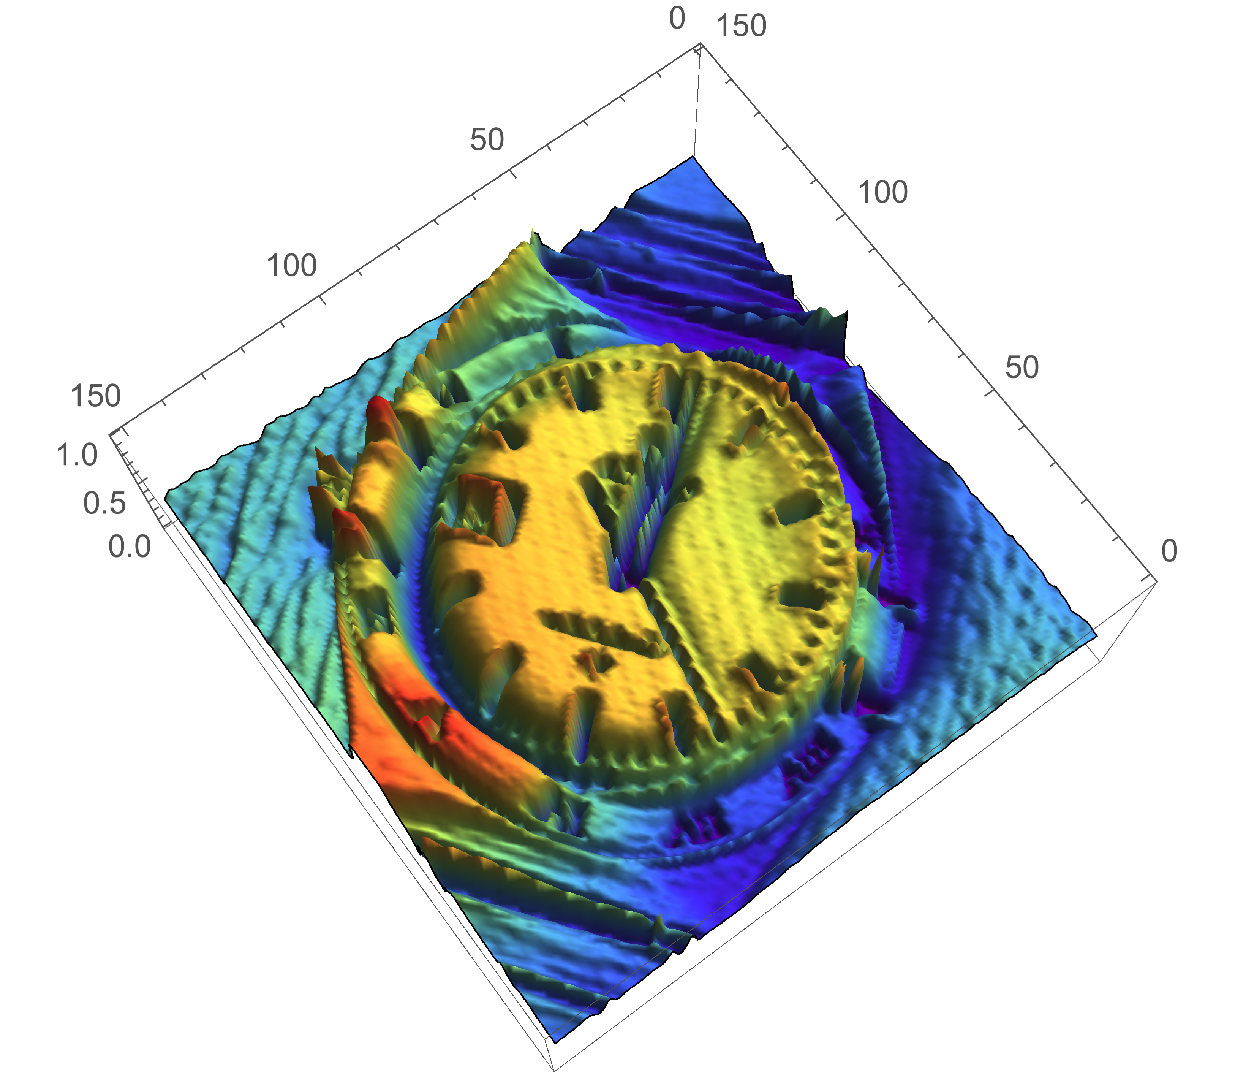
Gradients in Image
Imaging the direction that water flows ~~~
Notes:
Show the Mathematica animation

Slide 6
Matrix Form of Derivatives
G_{i}=Fx_{i}-Fx_{i+1}
1 | -1
-1 | 1
1
-1
-1
1
-1
 | 1
1
 | -1
They can also be considered as Filters!
-1 | 0 | 1
-1 | 0 | 1
-1 | 0 | 1
-1 | 0 | 1
-2 | 0 | 2
-1 | 0 | 1

Slide 7
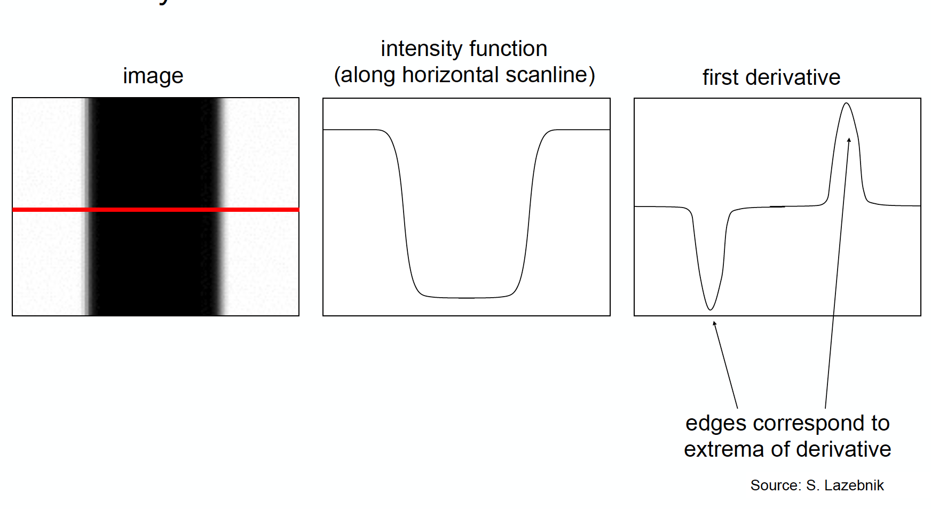
Intensity Change in Image
Rapid intensity variation

Slide 8
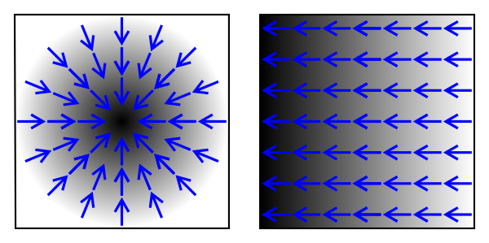
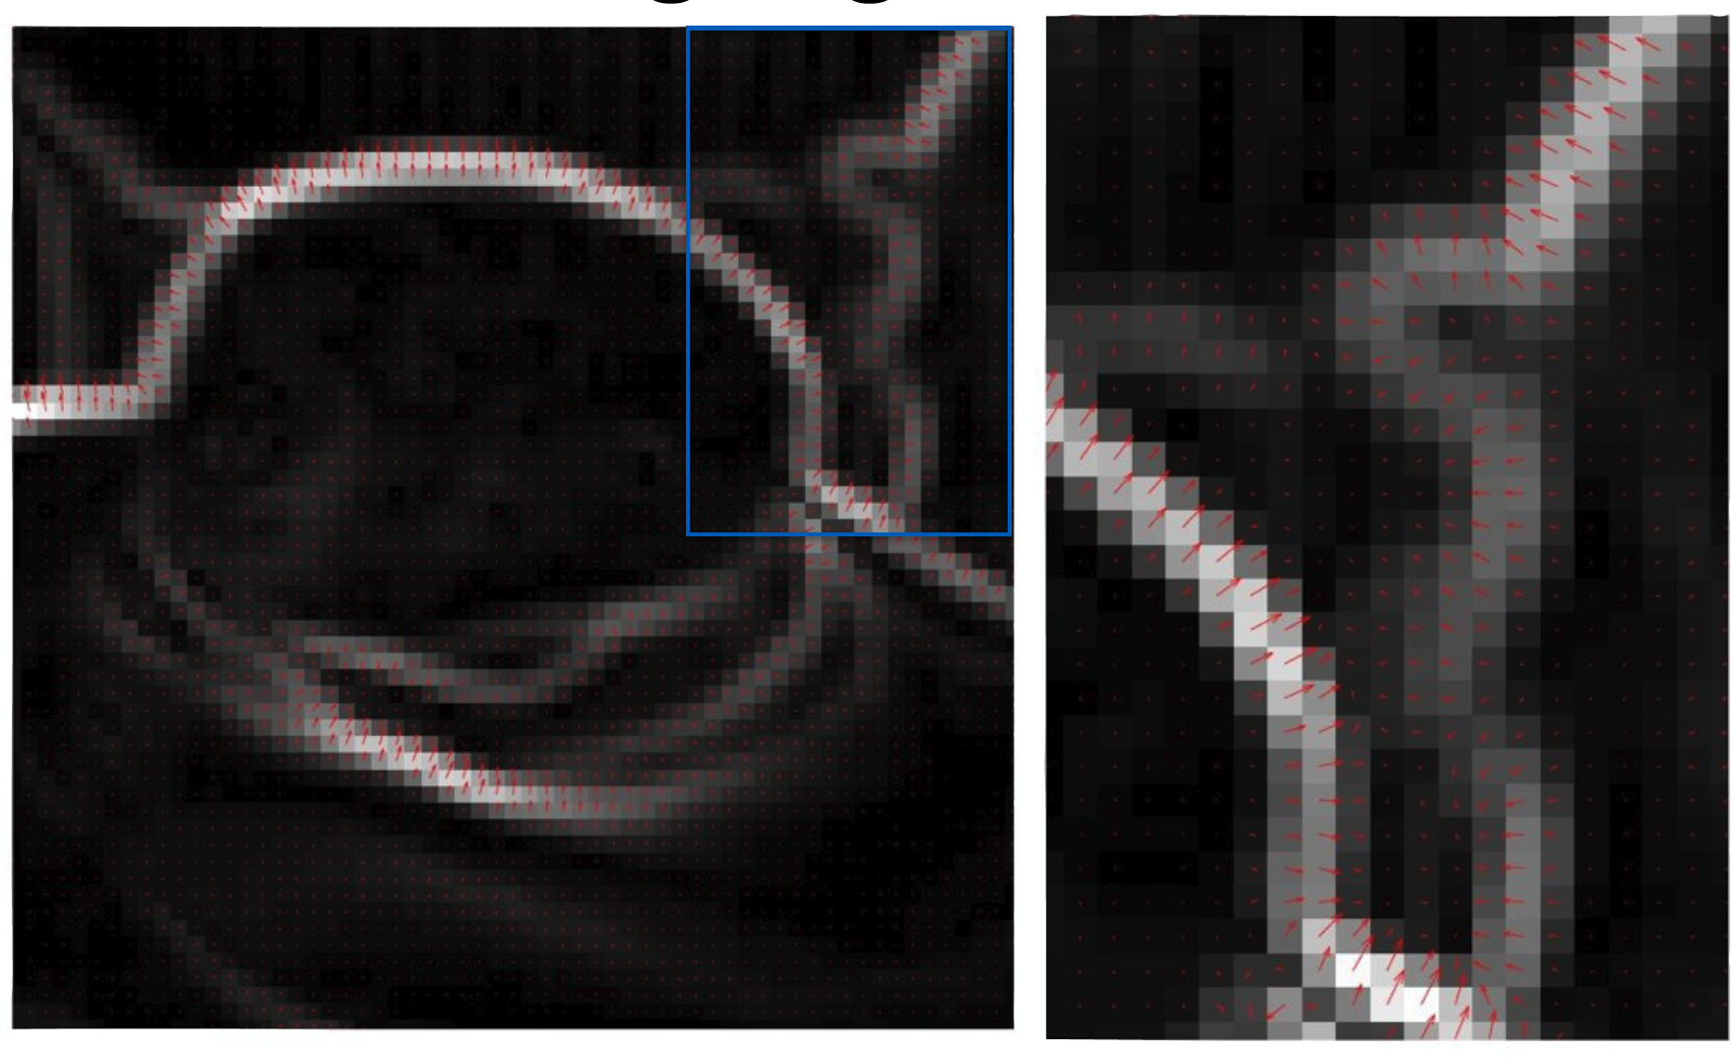
Vector Field
Gravitational Field
Electric Field
etc.
Gradient vector in image
Notes:
Magnetic field
Potential

Slide 9
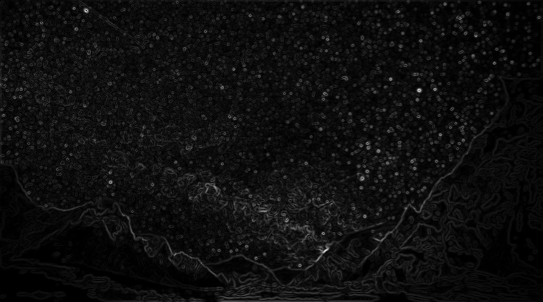
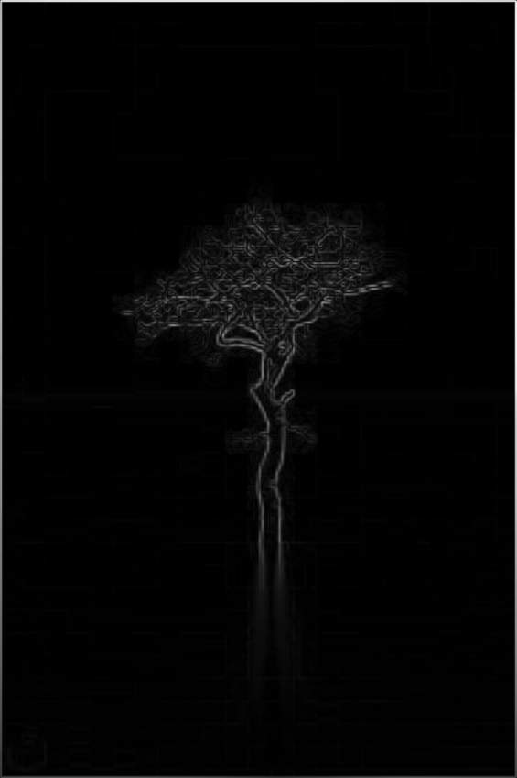
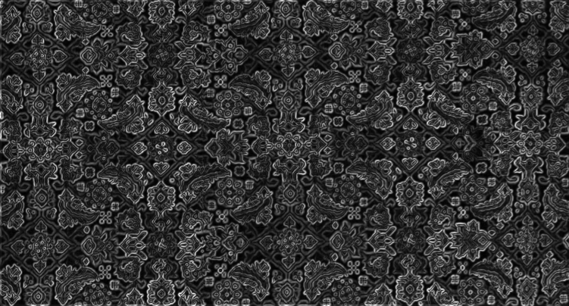
Changes in Images
Notes:
What is interesting part in image?
Reduce pixels we need to process

Slide 10
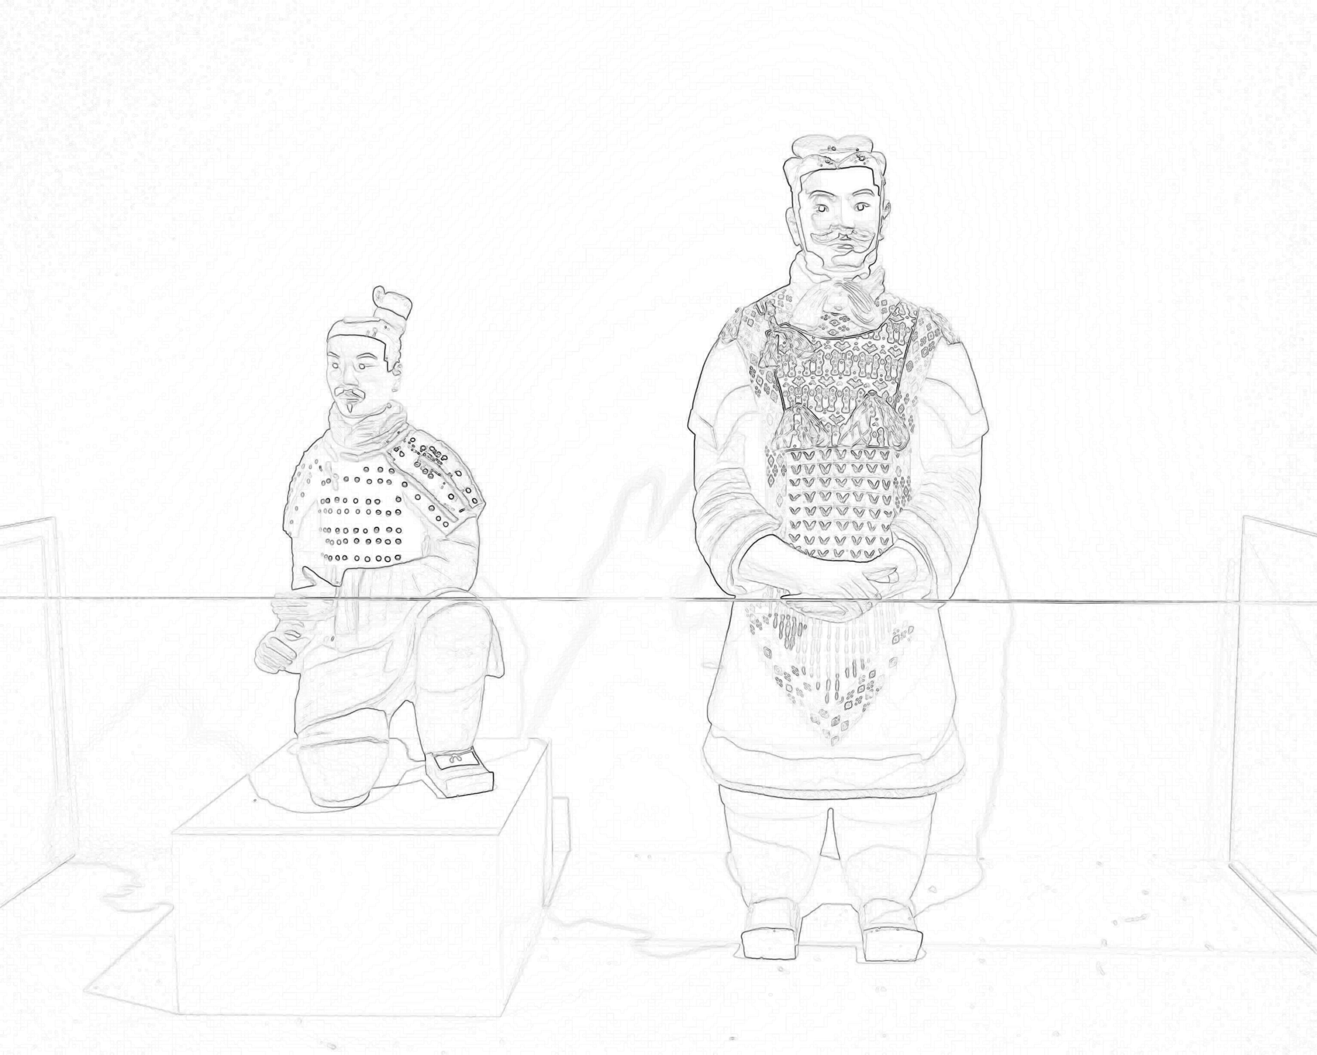
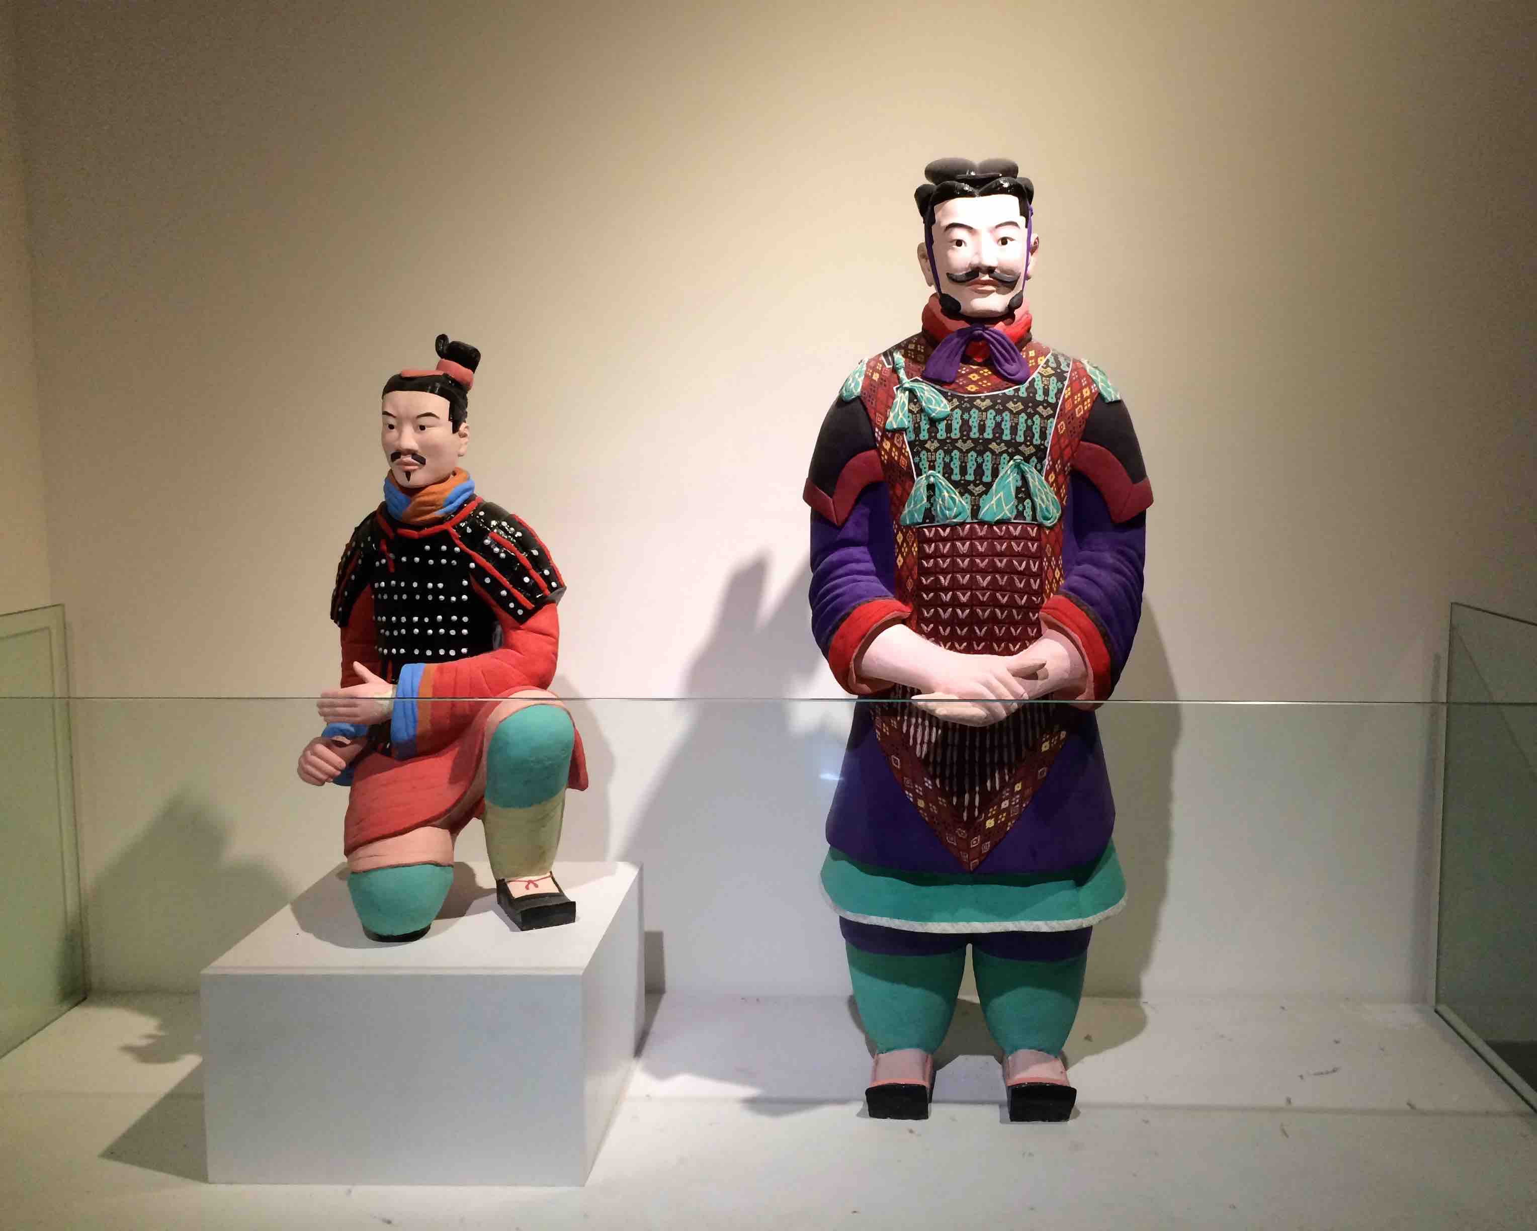
Origin of Edges
What is causing edges in an image?
Discontinuity
Surface normal
Surface color
Illumination
Depth
Material
etc.
Notes:
What is normal? Normalized cross product
What is color? Spectrum reflected or emitted by materials’ structure and received by eyes
Illumination? Strength of photo flux
Depth? Relative distance to the point of view
Material? Refractive index
Frame? Sensor size
Physics correspondence. Understand the physical world.

Slide 11

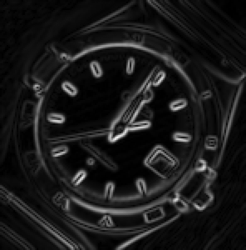

Edges in Image
Not that easy!
Brightness scale
Noise
Thickness
Discontinuity

Slide 12
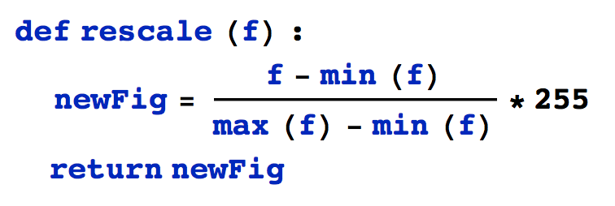
Rescaling
When visualizing the gradient, the image turns out to be mostly dark.

Slide 13
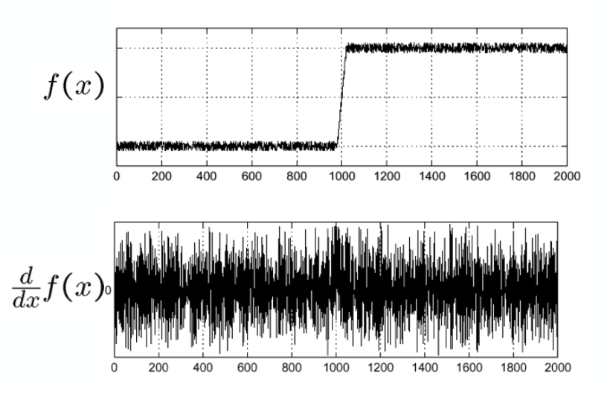
Noise
Effects on gradient calculation?
Where does noise come from?
- Shot noise -> Photon fluctuation
- Dark noise -> Electron fluctuation
- Read noise -> Reading error
- Irrelevant details
Noise comes from reality and cause distraction.
Computer vision is to find meaningful elements through abstraction.
How to remove noise?

Slide 14
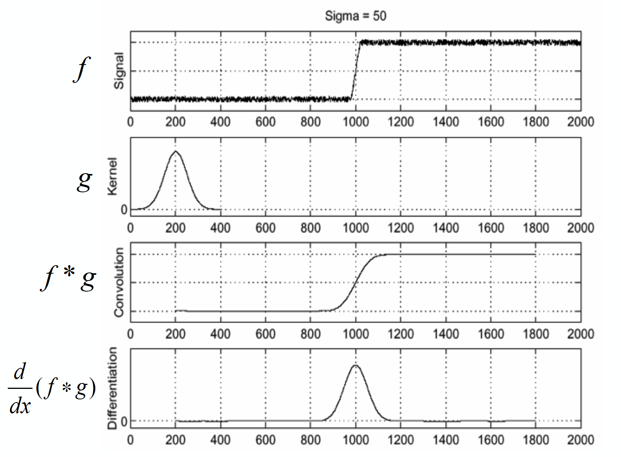
Smooth First

Slide 15
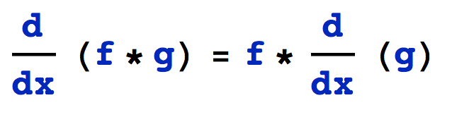
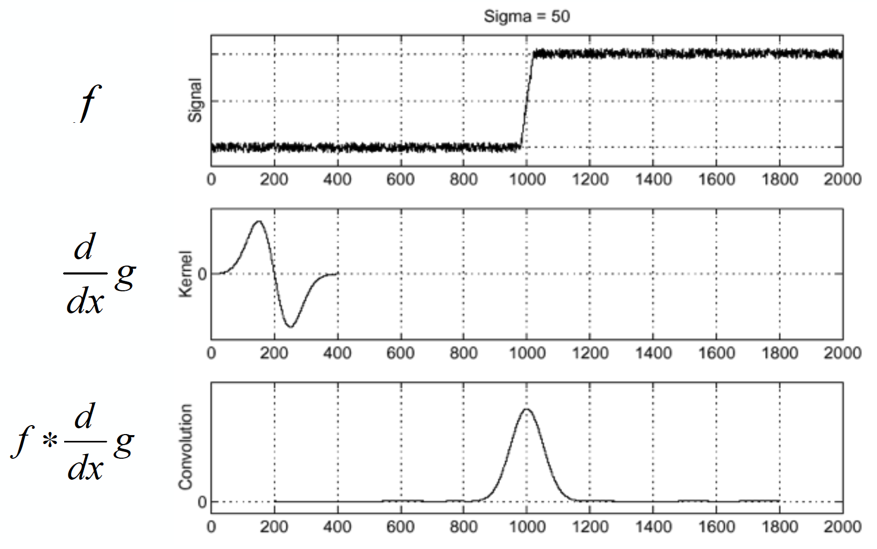
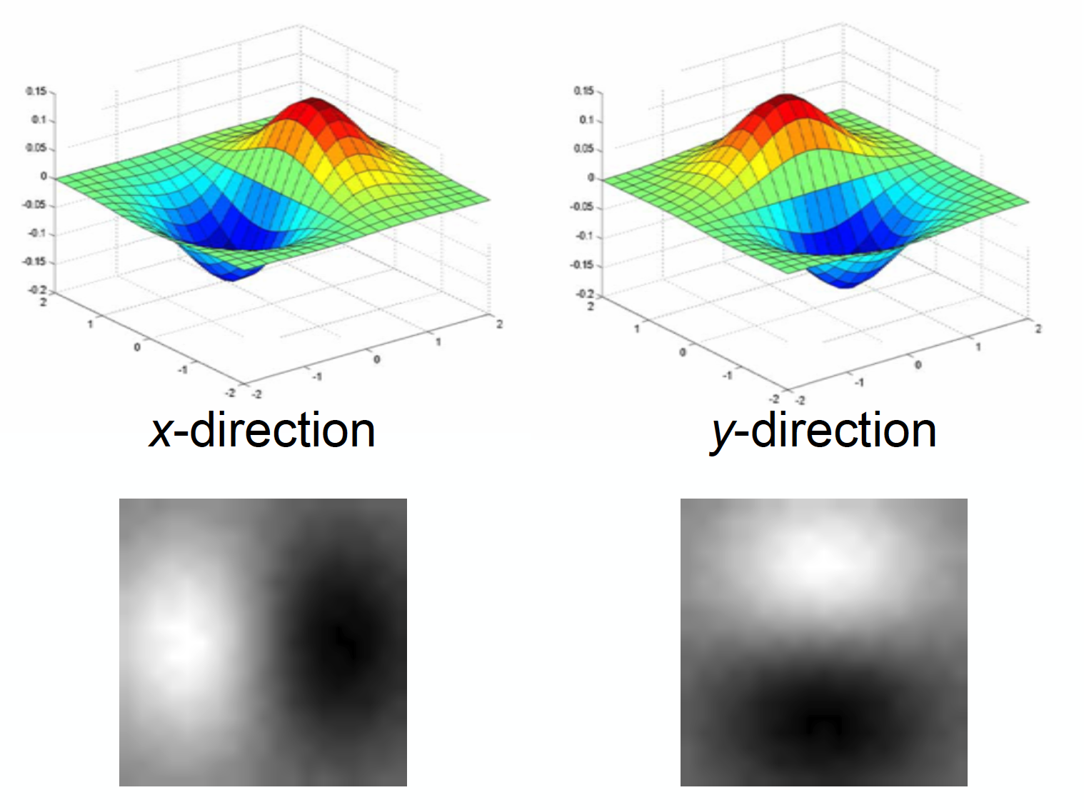
Derivative of Gaussian
Differentiation is convolution
Convolution is associative
Laplacian of Gaussian: Pre-calculated to reduce operations
Log

Slide 16
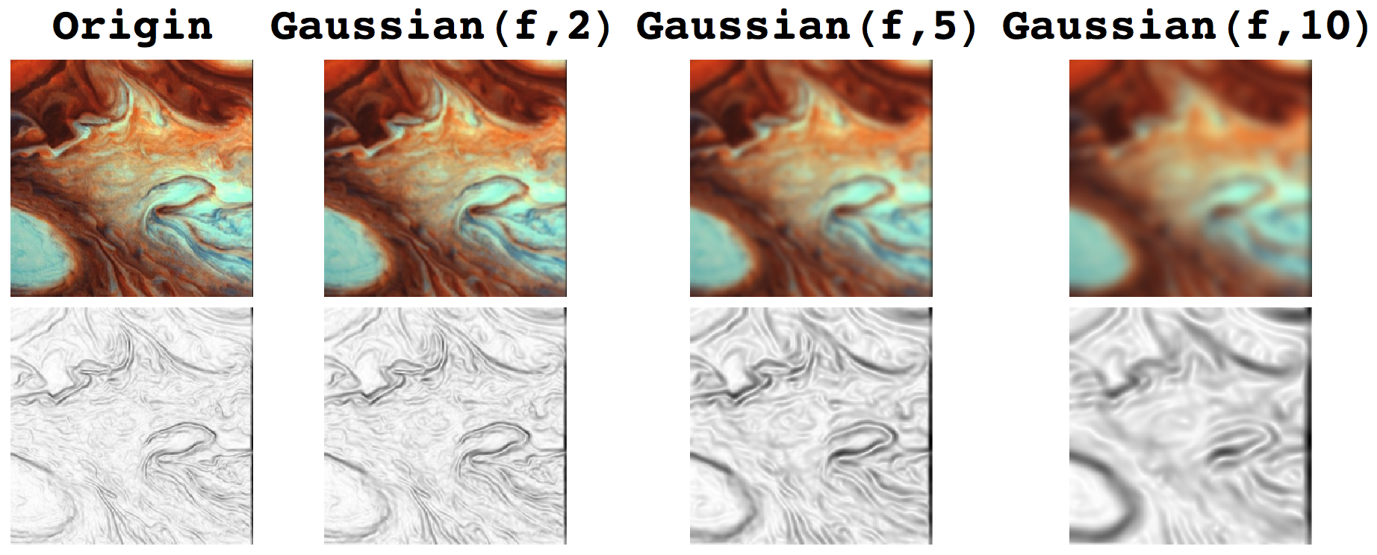
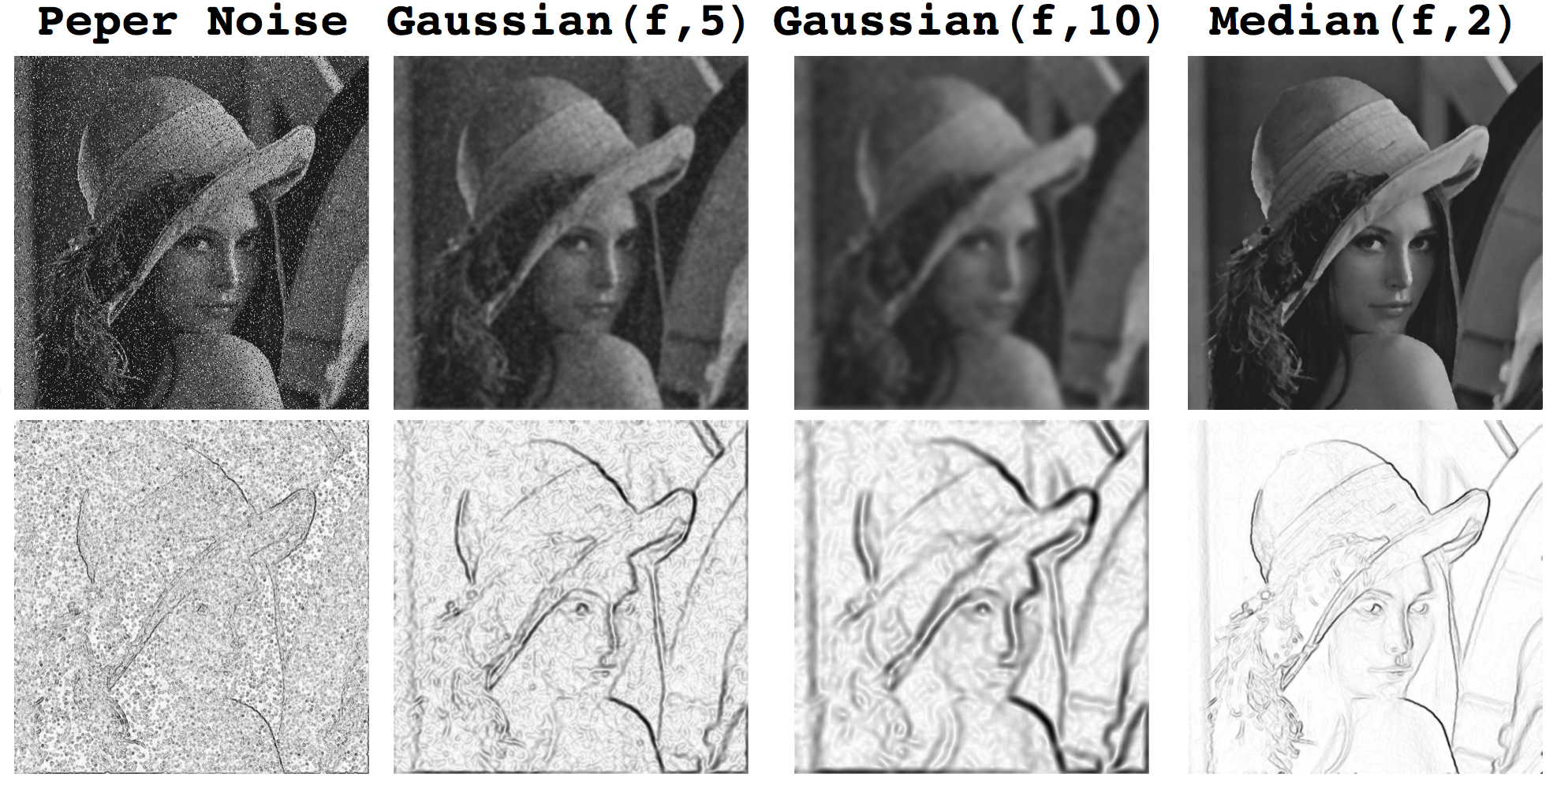
Smoothing Parameters
Gaussian
Blurring
Magic
Median
Blurring

Slide 17
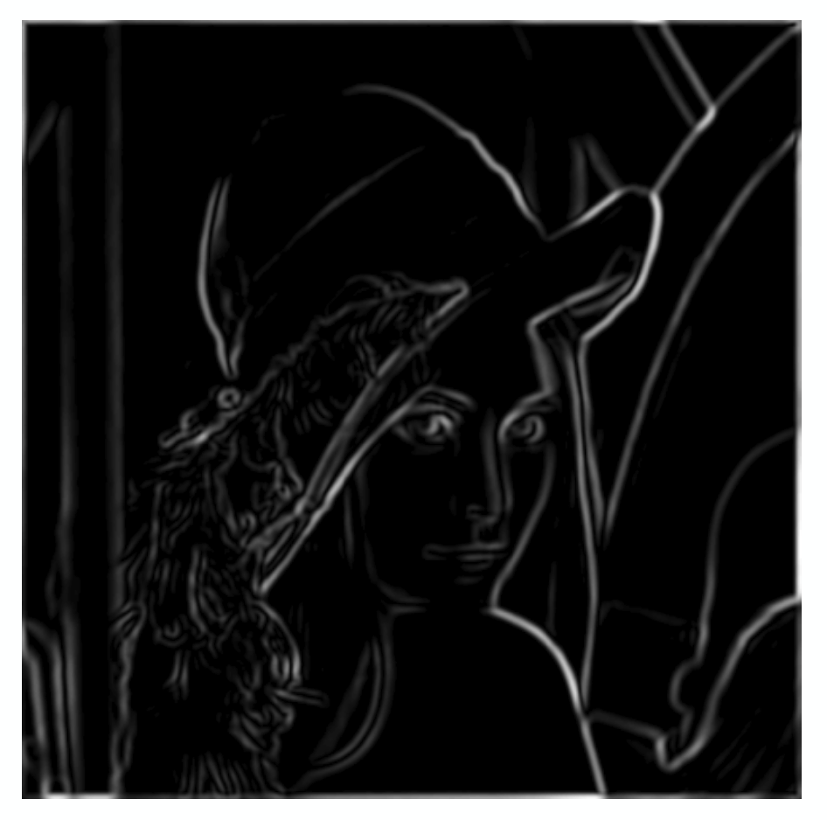
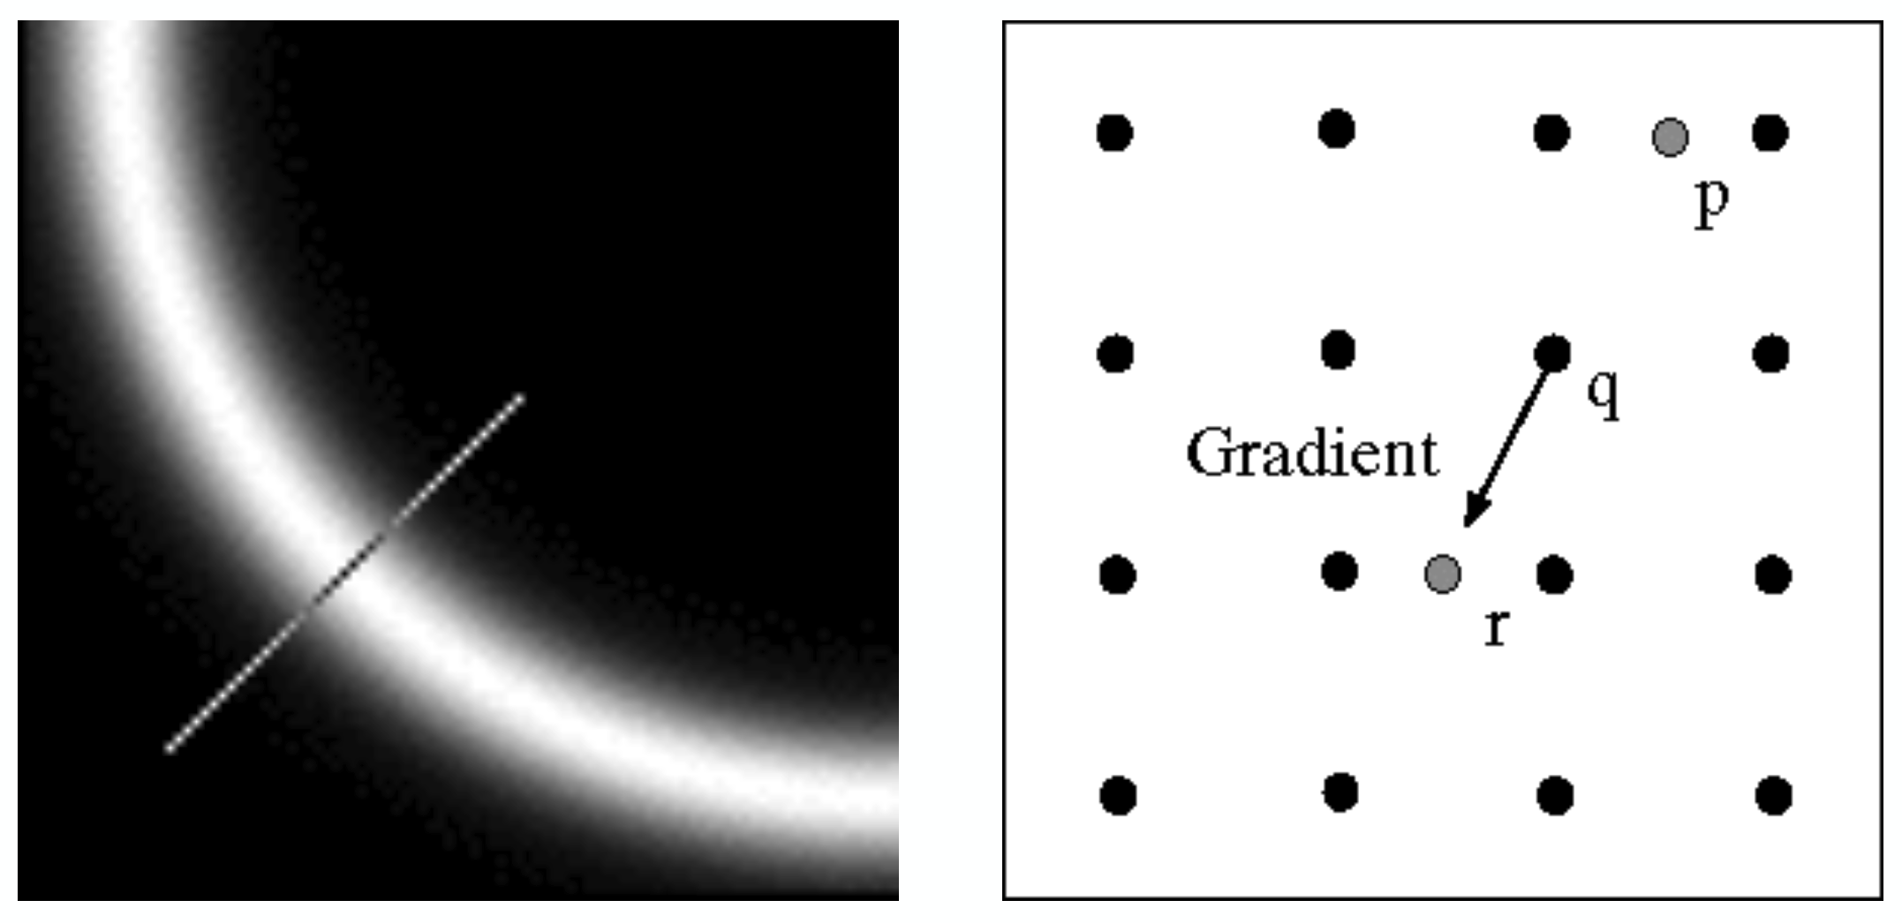
Non-maximum Suppression
Check if pixel is local maximum along gradient direction.
Select single max across width of the edge.

Slide 18
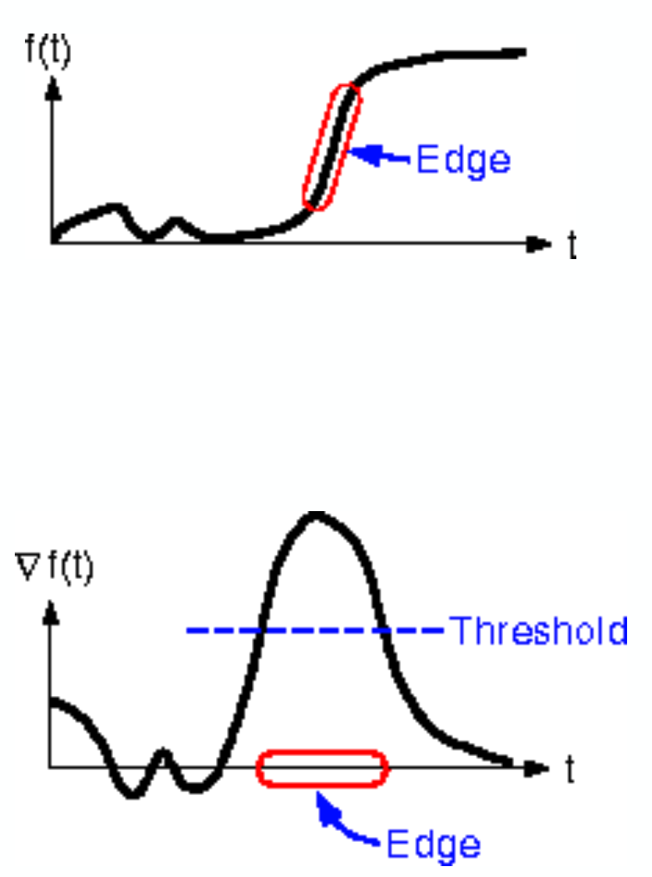

Linking and Thresholding
Use a high threshold to start edge curves, and a
low threshold to continue them.

Slide 19
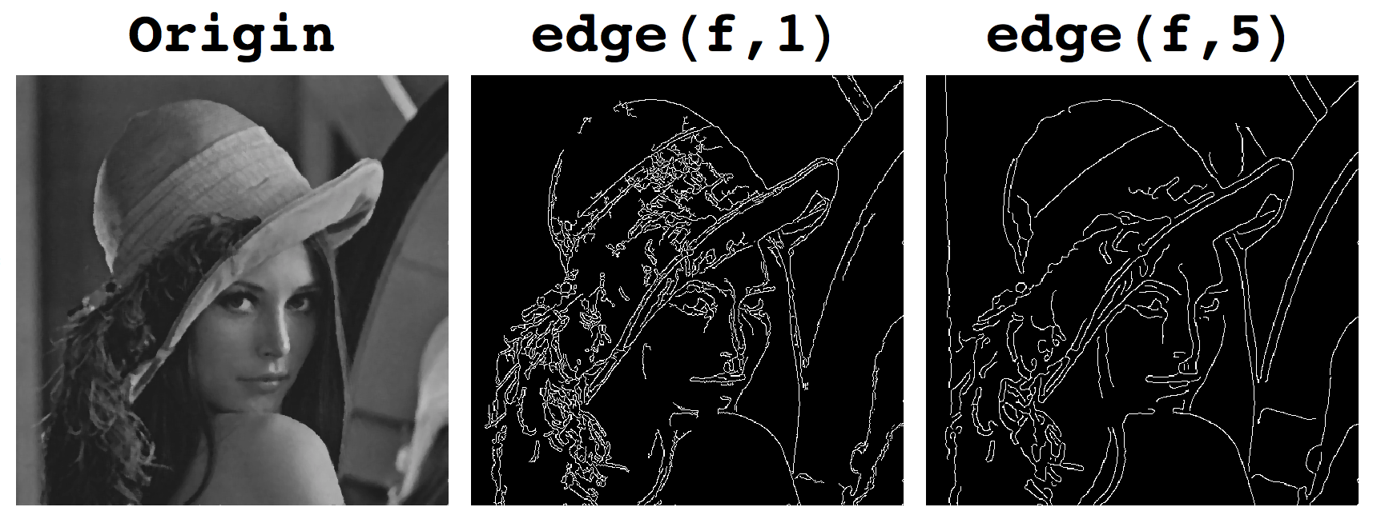
Canny Edge Detection
Filter image with derivative of Gaussian (LoG)
Find magnitude and orientation of gradient
Non-maximum suppression:
- Thin wide “ridges” down to single pixel width
Linking and thresholding (hysteresis):
- Define two thresholds: low and high
- Use the high threshold to start edge curves and the
low threshold to continue them

